Slide 1

Overview
Notes:
textbox
No alt text provided
textbox
No alt text provided
slicer
No alt text provided
slicer
No alt text provided
Month
No alt text provided
sda
No alt text provided
sda
No alt text provided
sda
No alt text provided
Revenue By Sub Category
No alt text provided
Revenue By Category
No alt text provided
Revenue By Product
No alt text provided
pivotTable
No alt text provided
Revenue By Category
No alt text provided

Slide 2
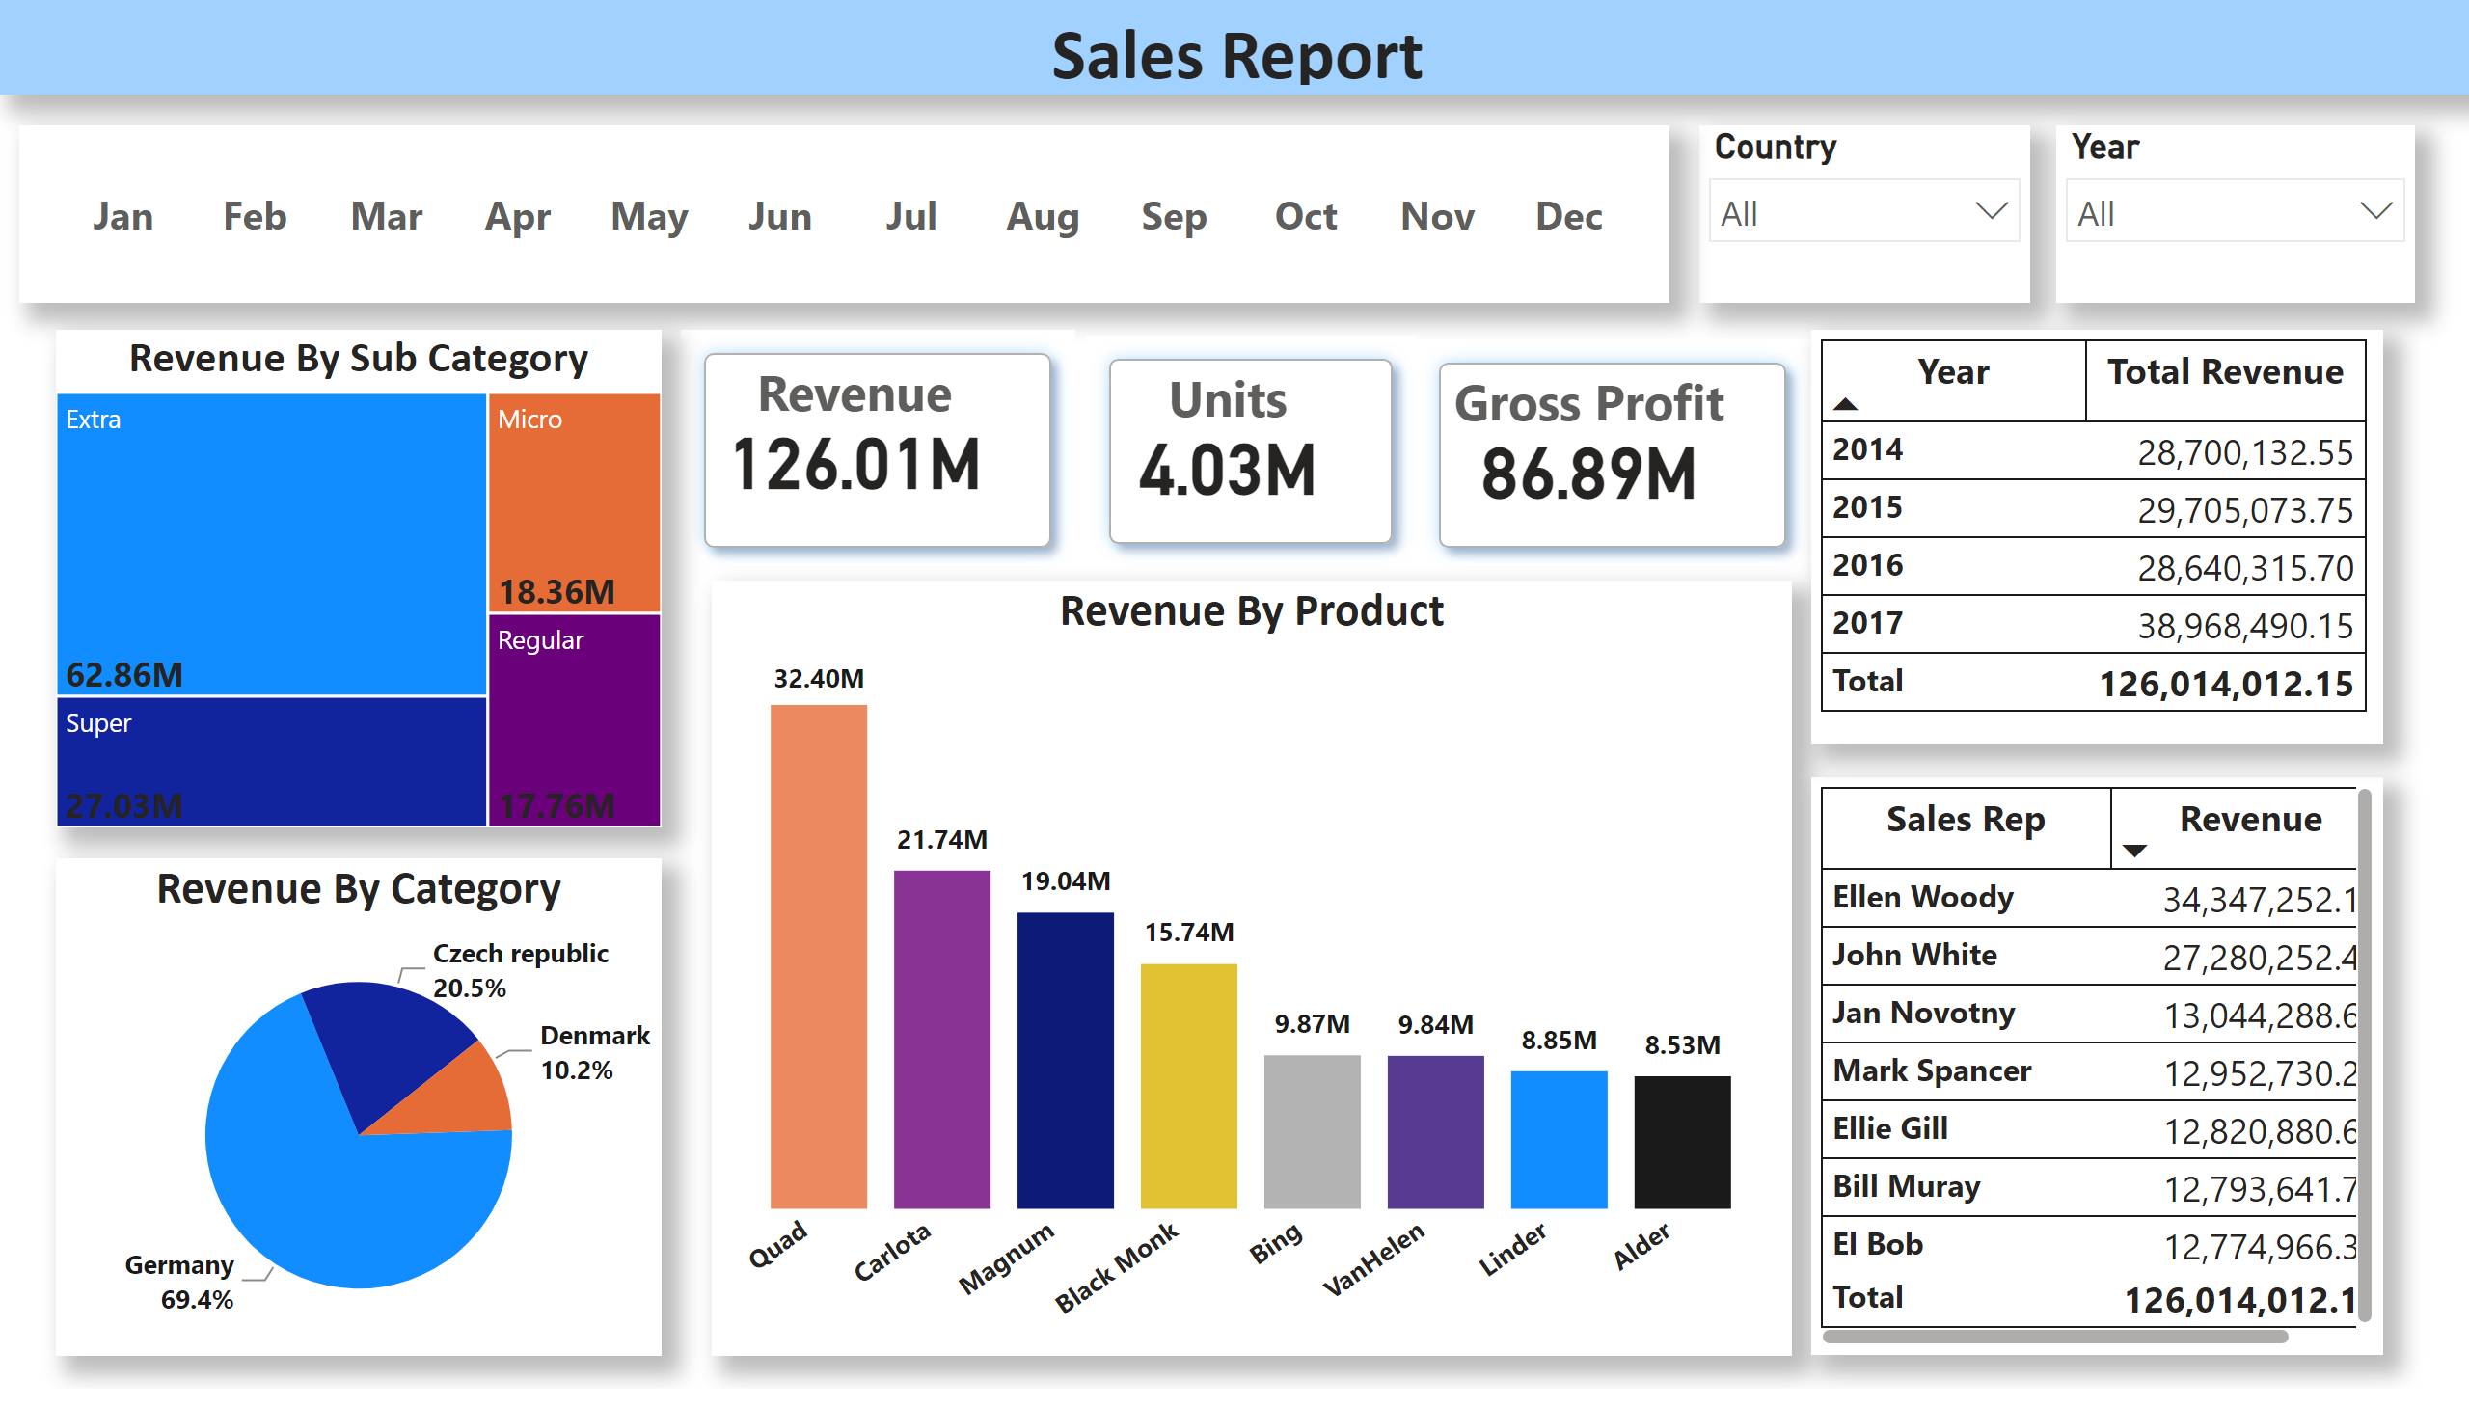
Overview
Notes:
textbox
No alt text provided
textbox
No alt text provided
slicer
No alt text provided
slicer
No alt text provided
Month
No alt text provided
sda
No alt text provided
sda
No alt text provided
sda
No alt text provided
Revenue By Sub Category
No alt text provided
Revenue By Category
No alt text provided
Revenue By Product
No alt text provided
pivotTable
No alt text provided
Revenue By Category
No alt text provided

Slide 3
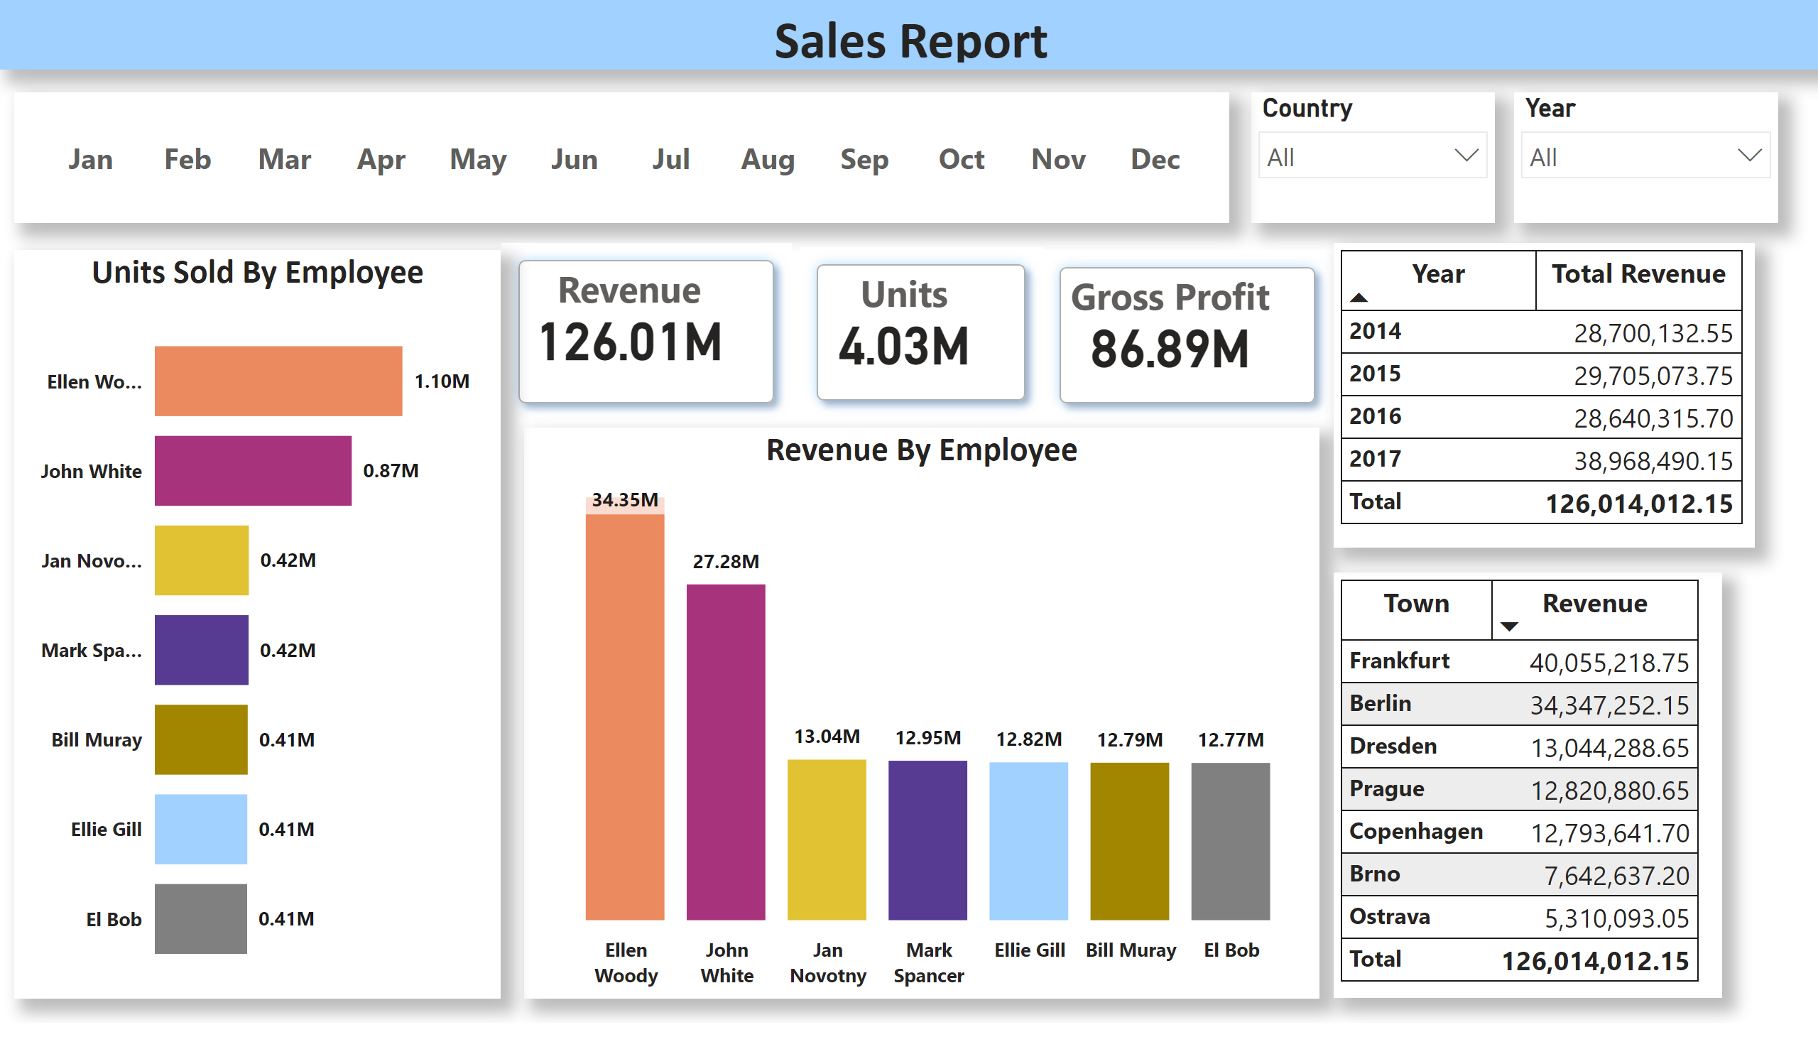
Employee Based Analysis
Notes:
textbox
No alt text provided
textbox
No alt text provided
slicer
No alt text provided
slicer
No alt text provided
Month
No alt text provided
sda
No alt text provided
sda
No alt text provided
sda
No alt text provided
Revenue By Employee
No alt text provided
pivotTable
No alt text provided
Revenue By Category
No alt text provided
Units Sold By Employee
No alt text provided

Slide 4
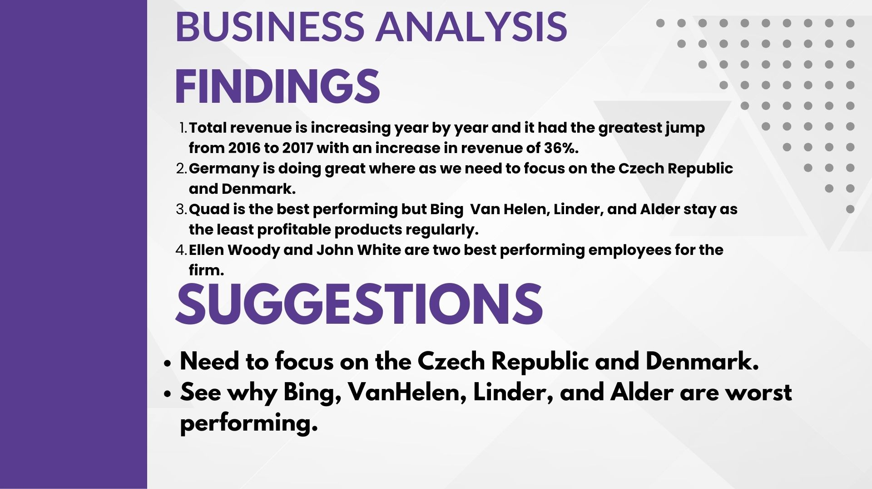
Employee Based Analysis
Notes:
textbox
No alt text provided
textbox
No alt text provided
slicer
No alt text provided
slicer
No alt text provided
Month
No alt text provided
sda
No alt text provided
sda
No alt text provided
sda
No alt text provided
Revenue By Employee
No alt text provided
pivotTable
No alt text provided
Revenue By Category
No alt text provided
Units Sold By Employee
No alt text provided

